Slide 1
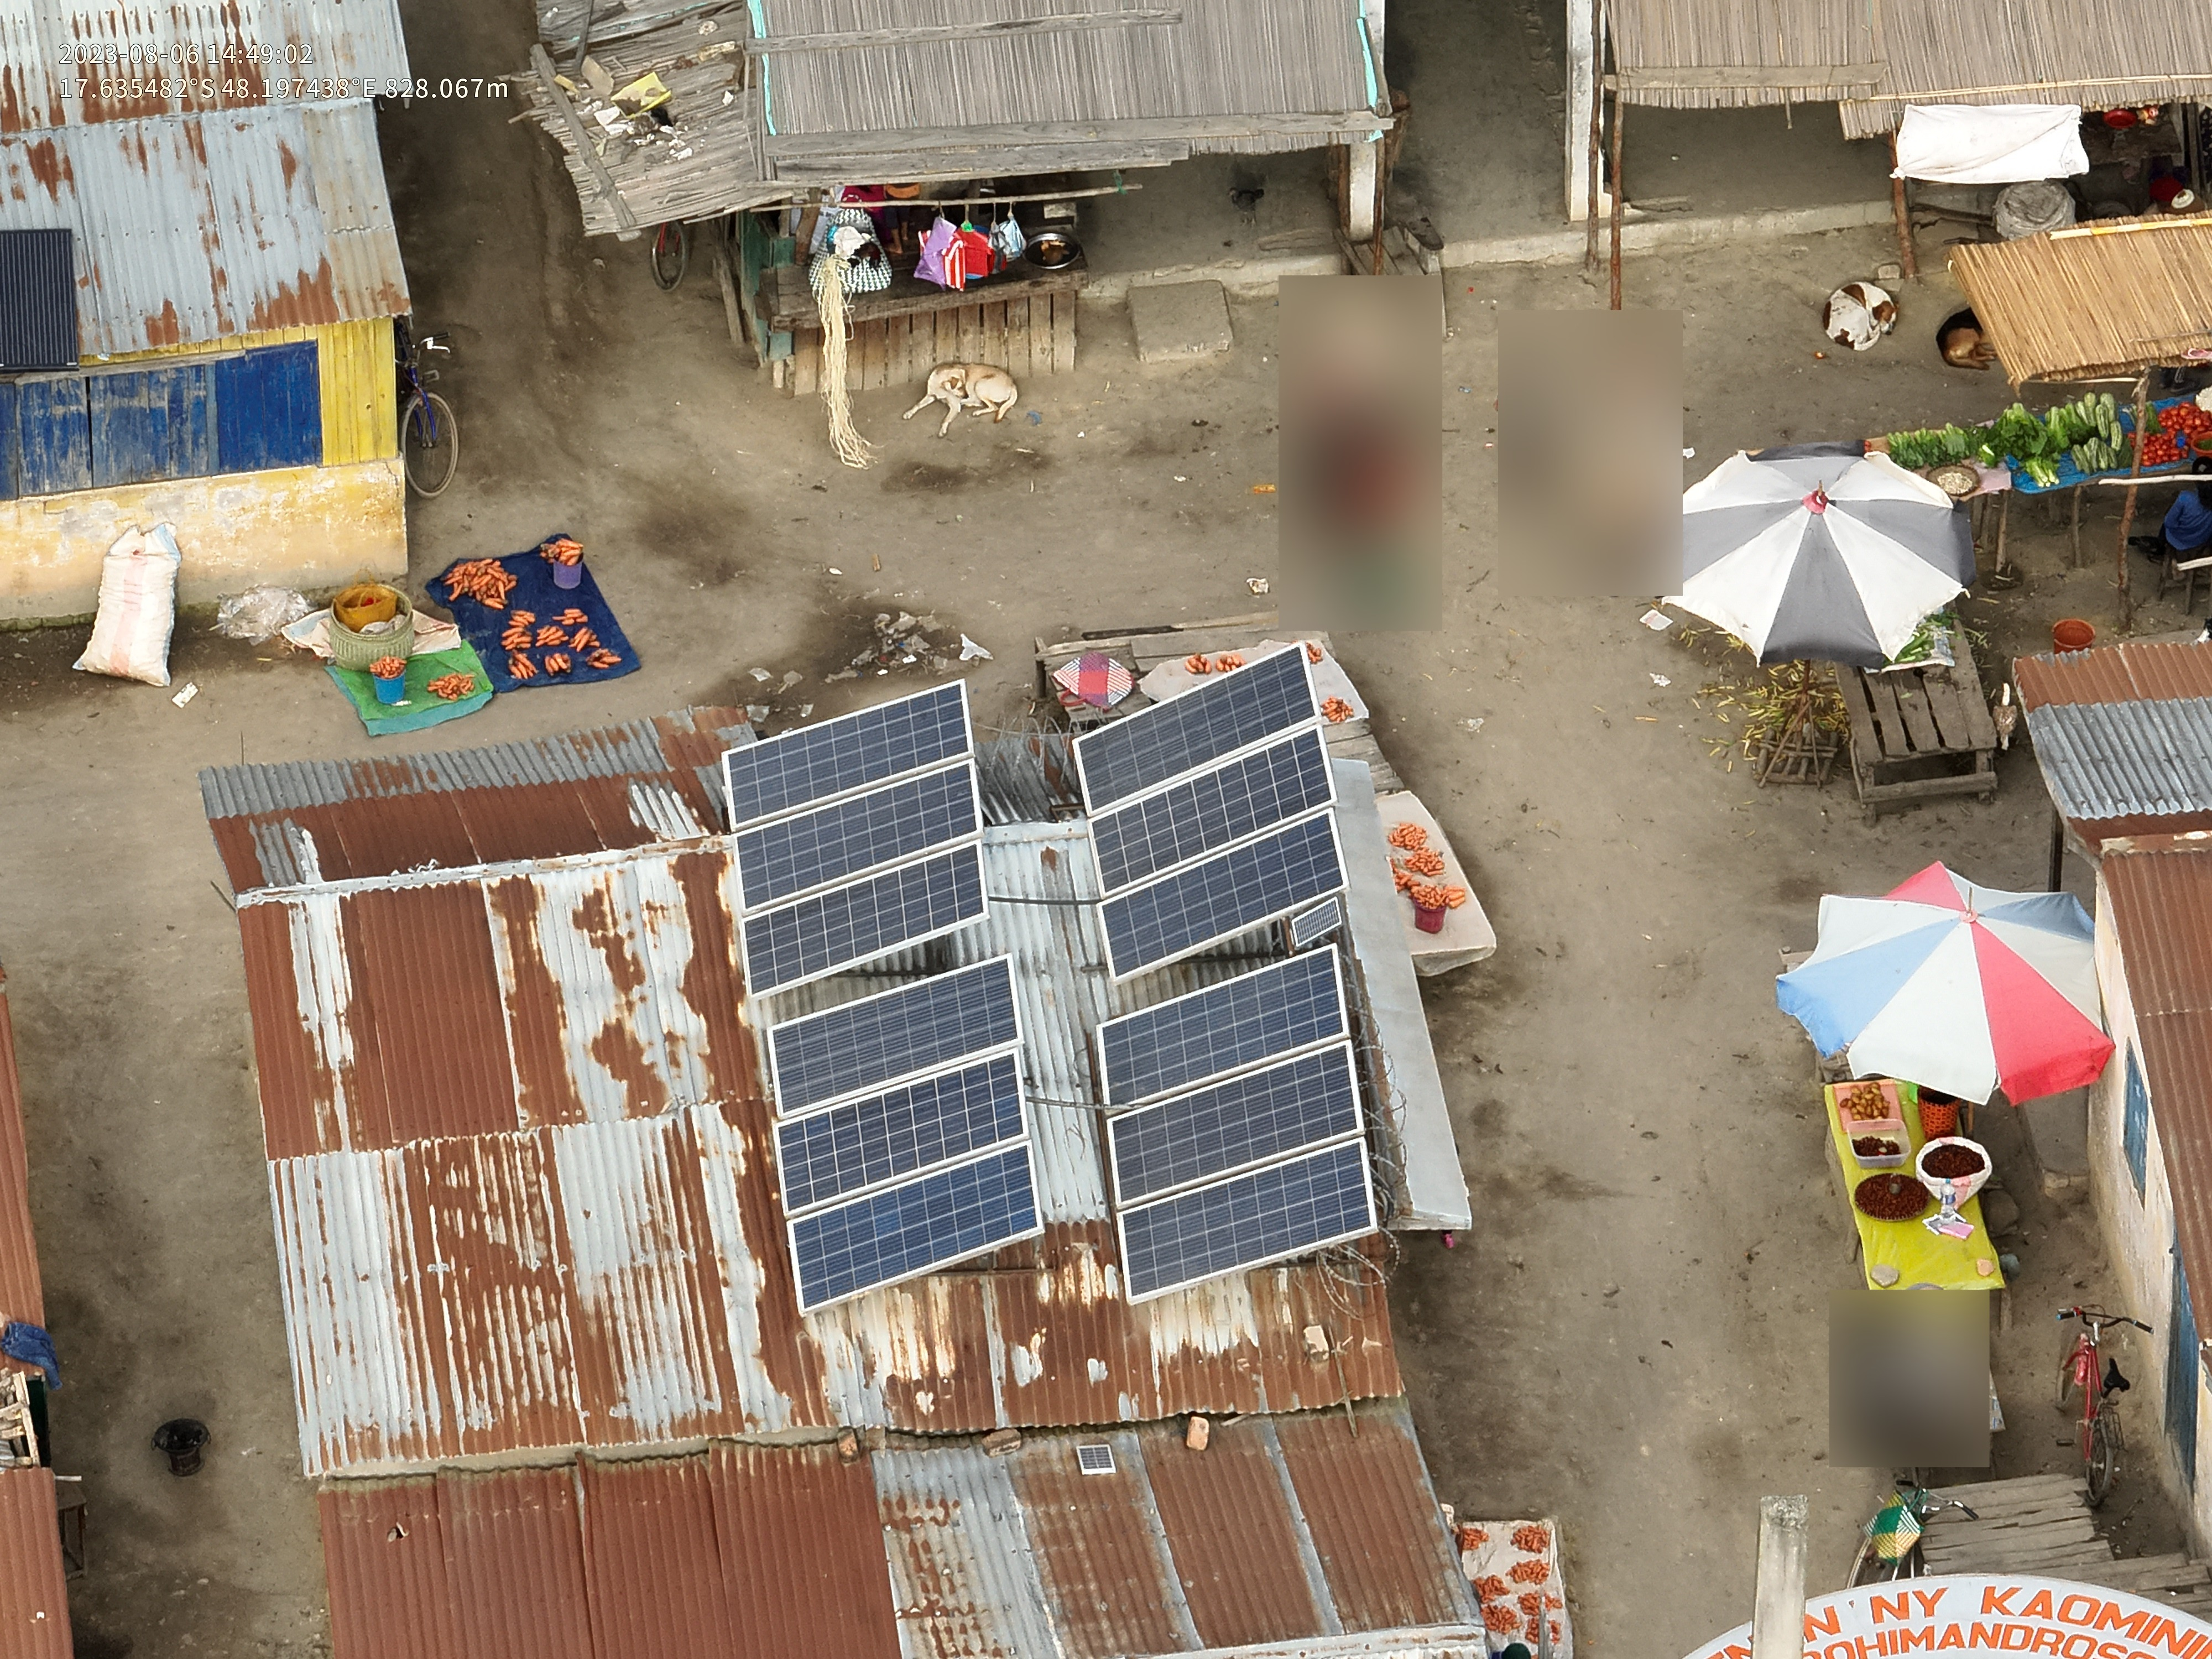
Counting Photovoltaic and Solar Panels from Aerial Imagery
Lacuna Solar Survey Challenge
Hugo Veríssimo 124348
João Cardoso 50750
Complements of Machine Learning 24/25

Slide 2
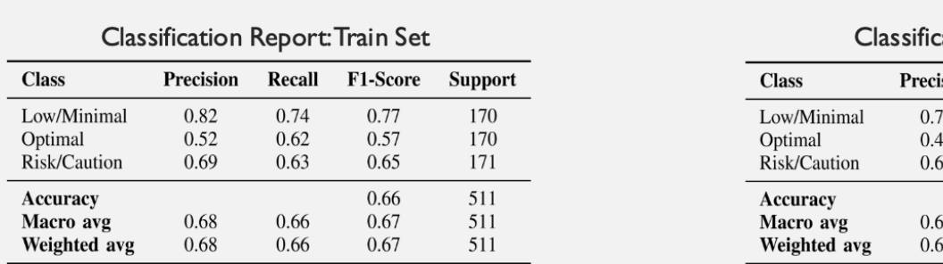
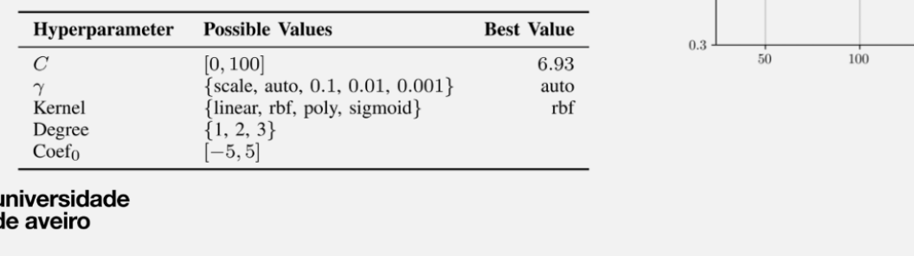
NOTAS:!:!:!:!::!
TABELAS
TEXTOS
…

Slide 3

contents
Project Overview
Data Analysis
Deep Learning Models
Results Analysis

Slide 4
Project Overview

Slide 5
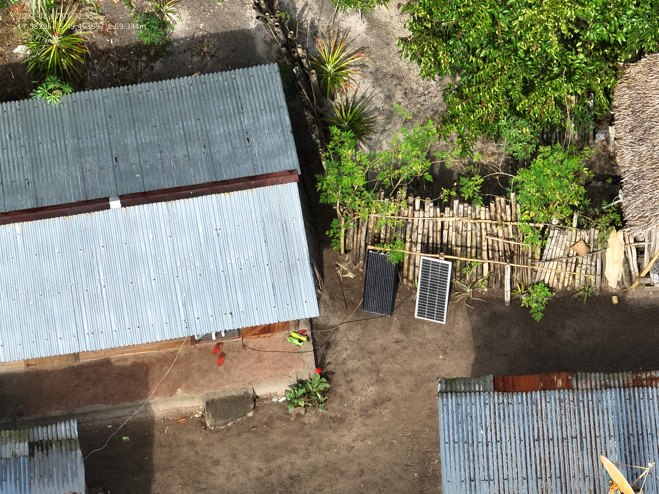
The problem

Slide 6
State of the art

Slide 7
Data analysis

Slide 8
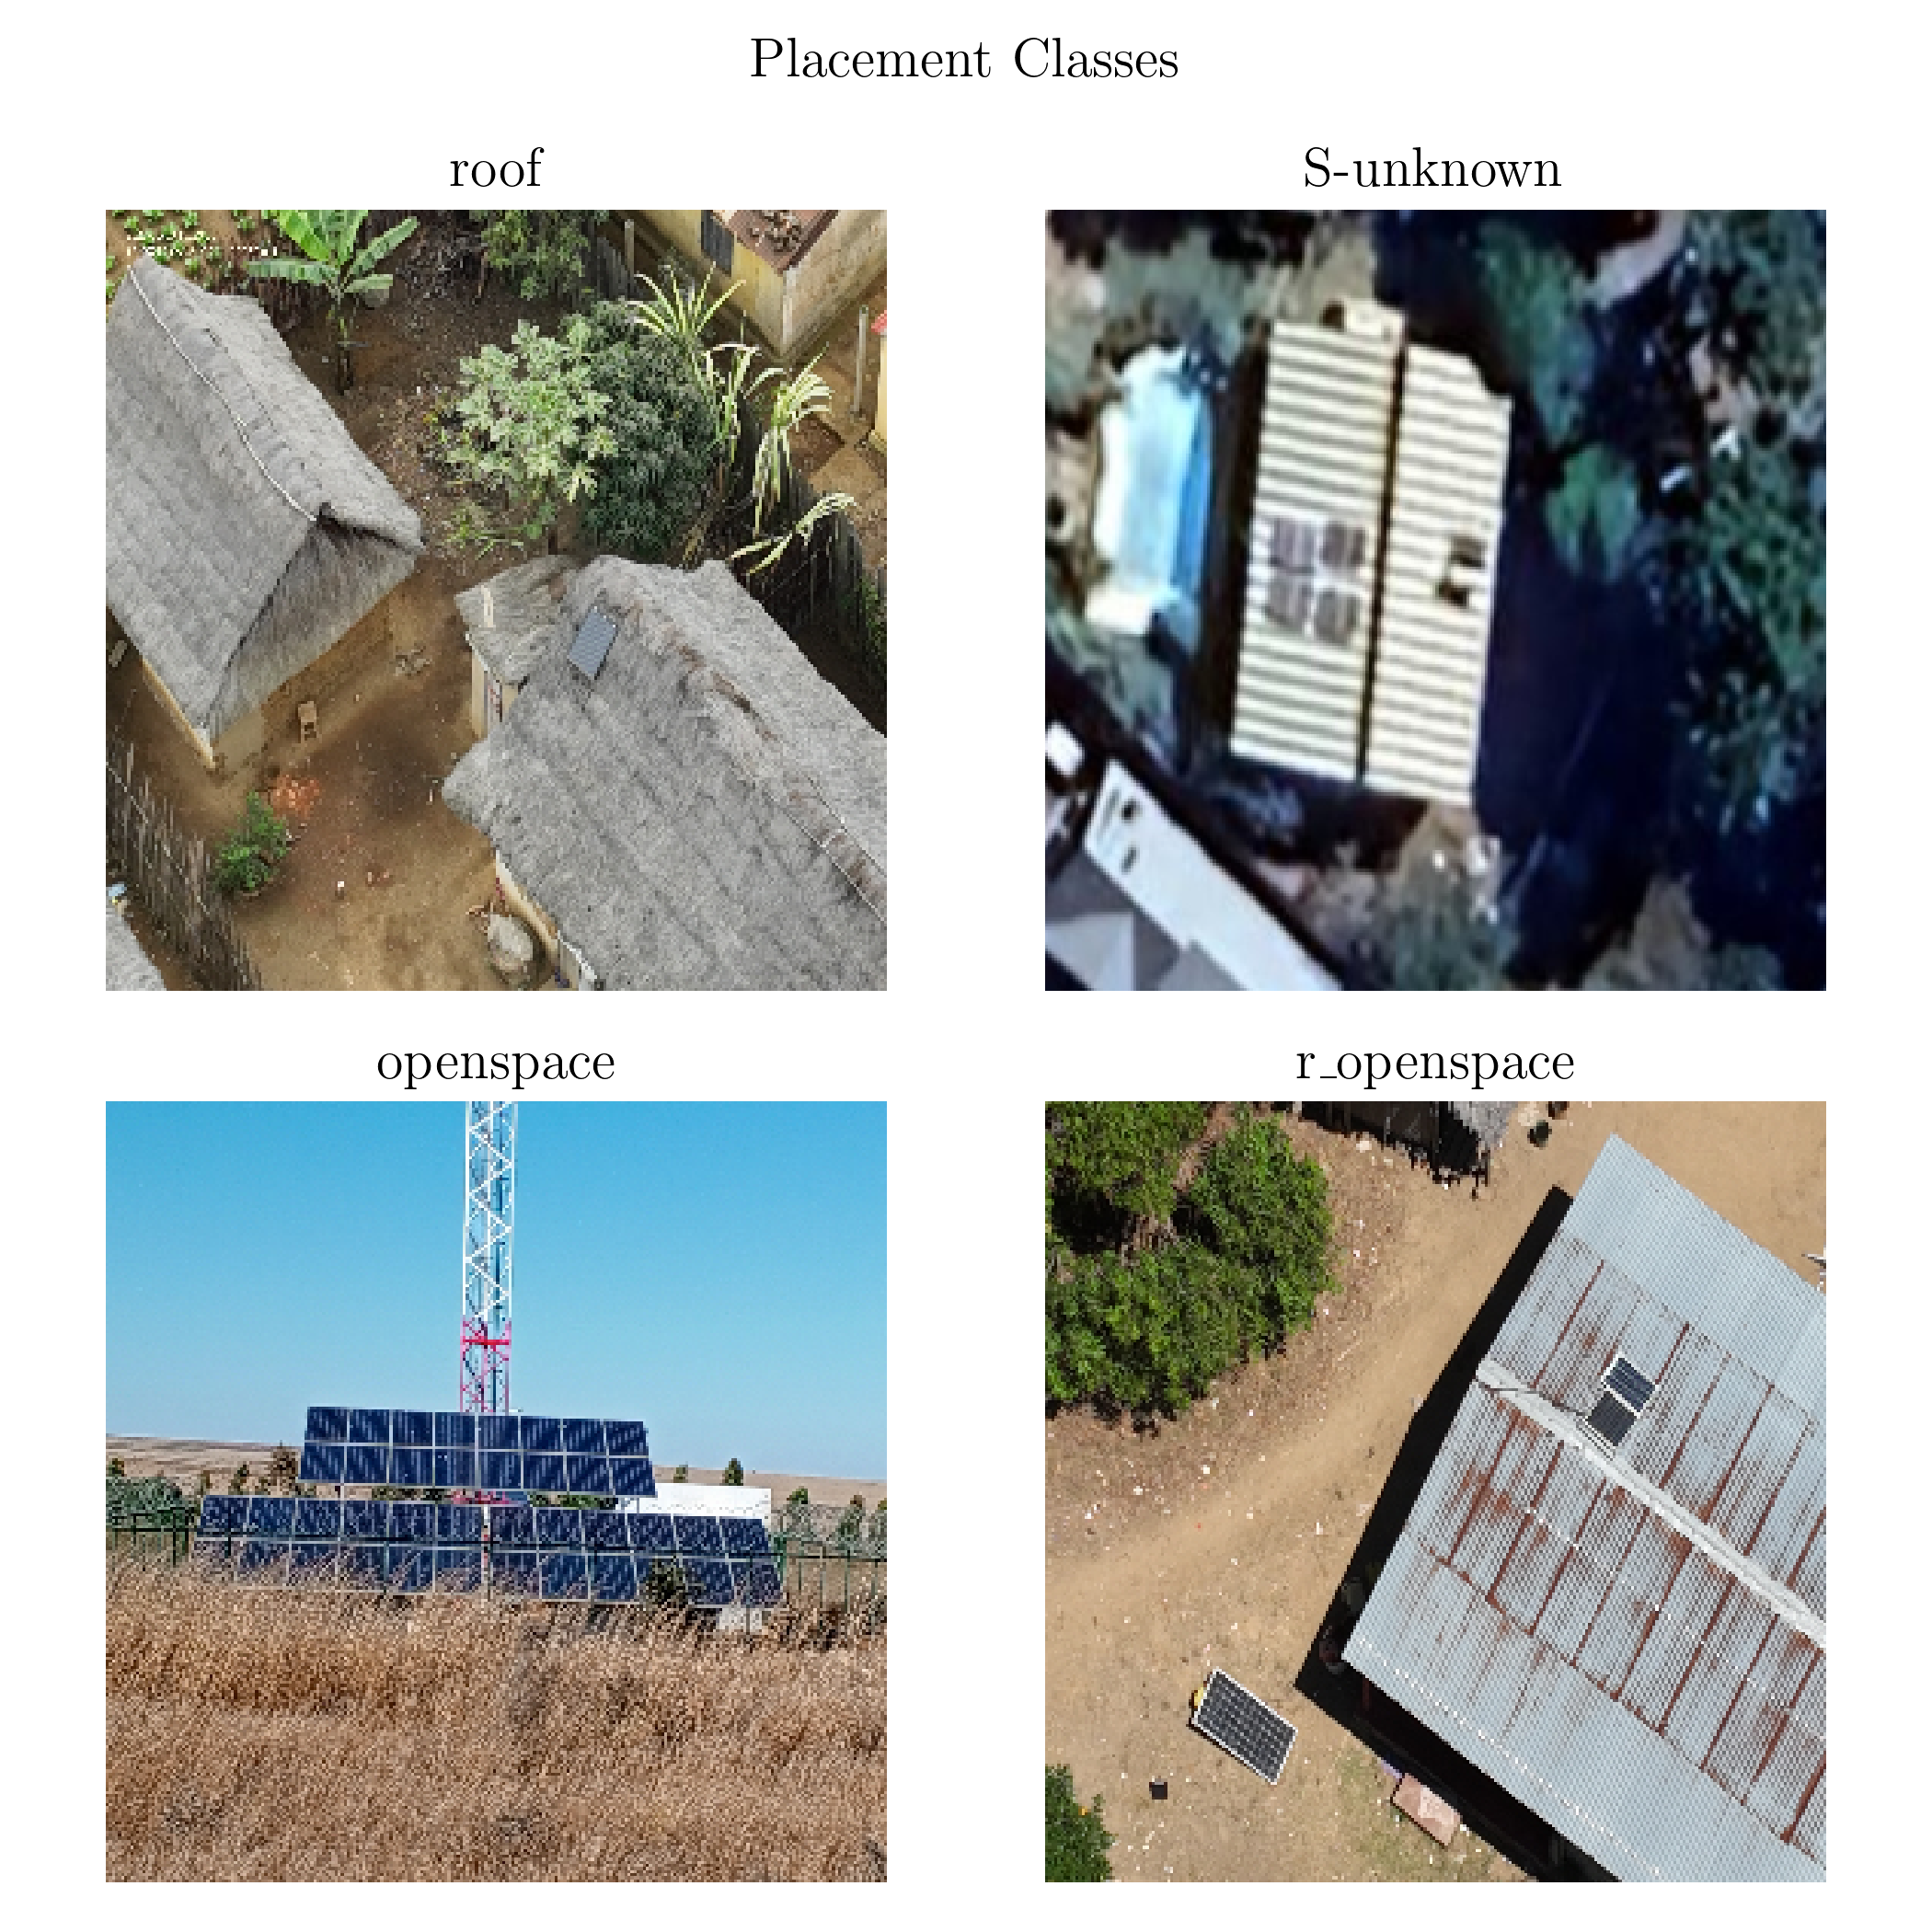
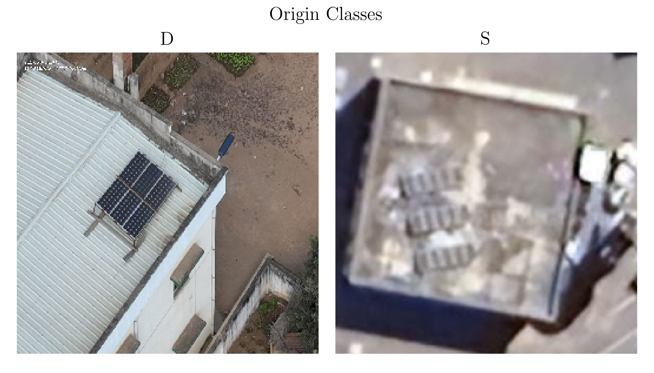
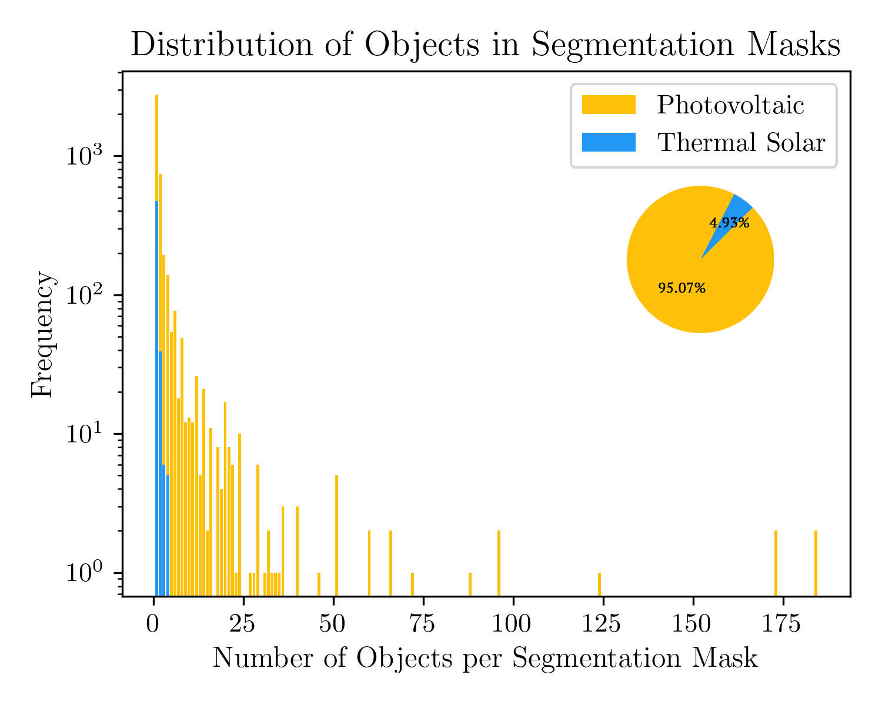
Raw data

Slide 9
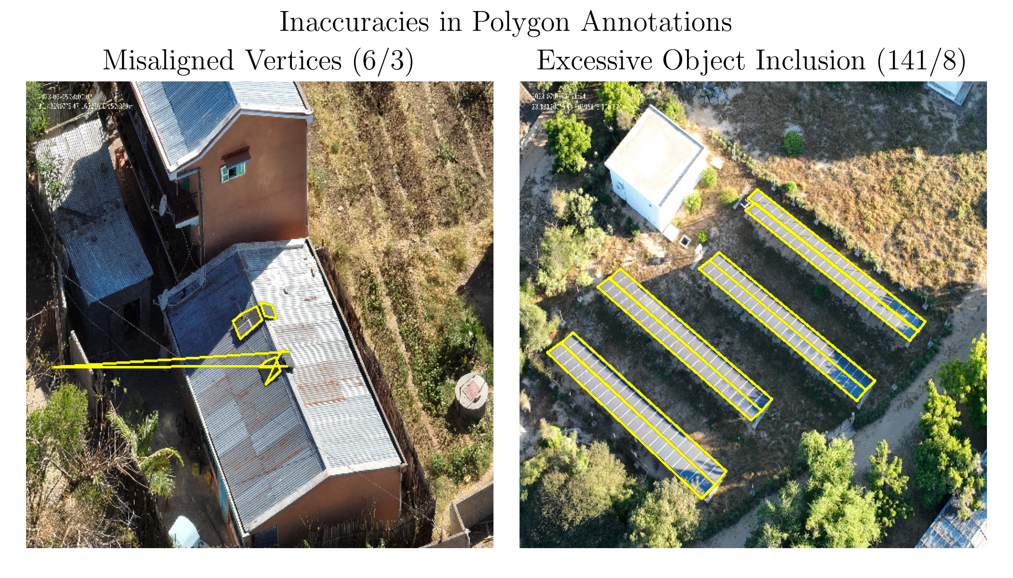
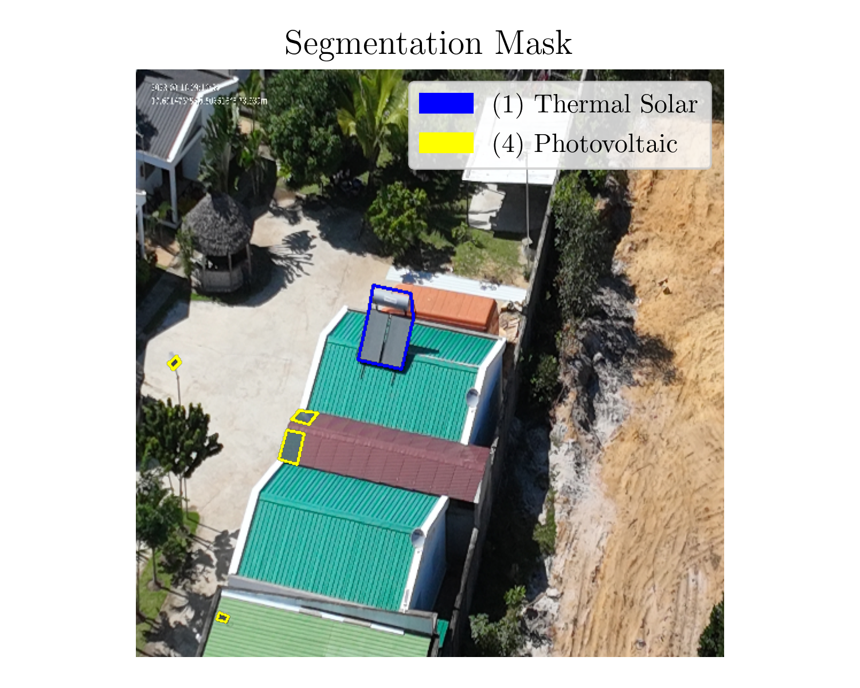
…

Slide 10
solutions

Slide 11
Deep learning models

Slide 12
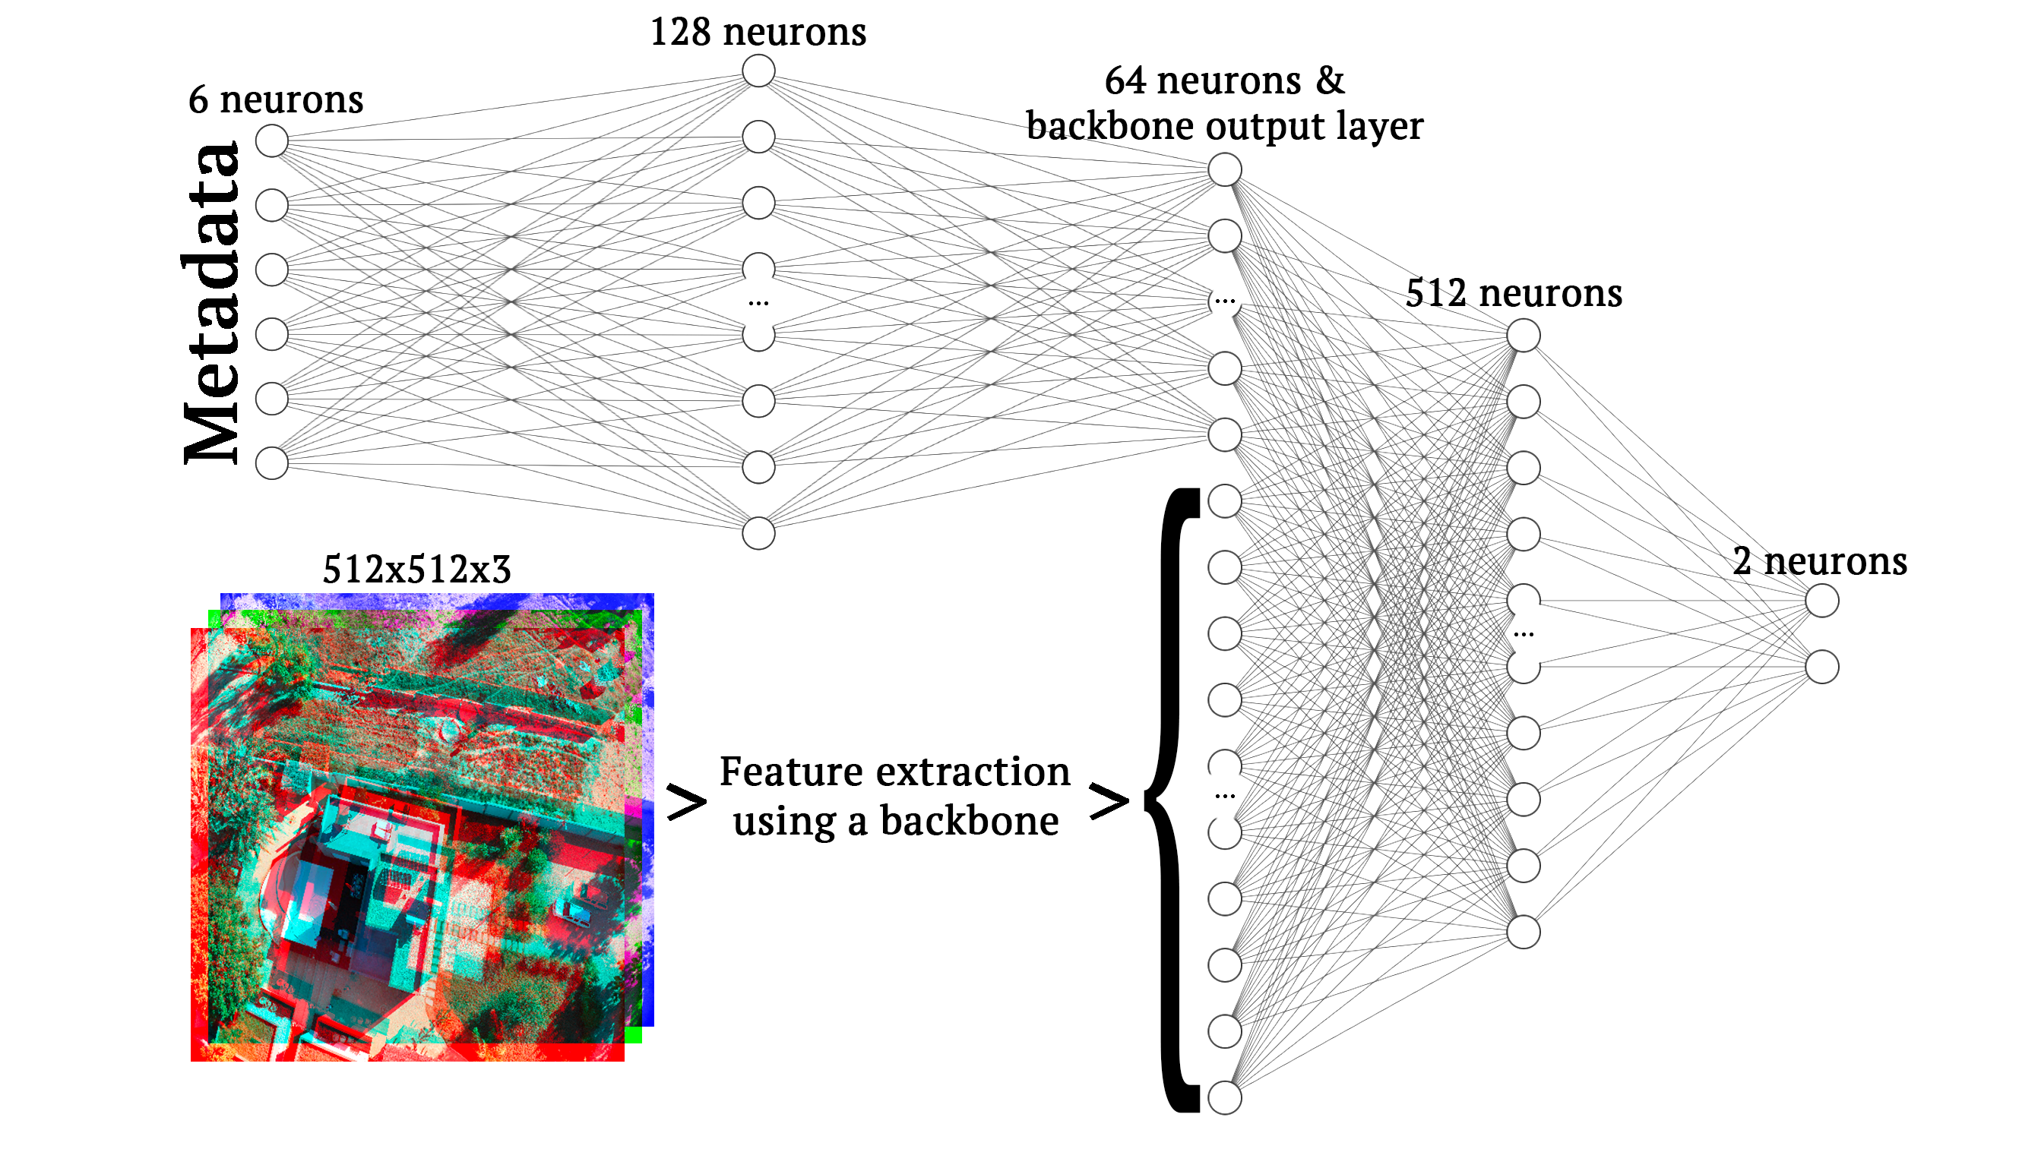
Image-based Regression

Slide 13
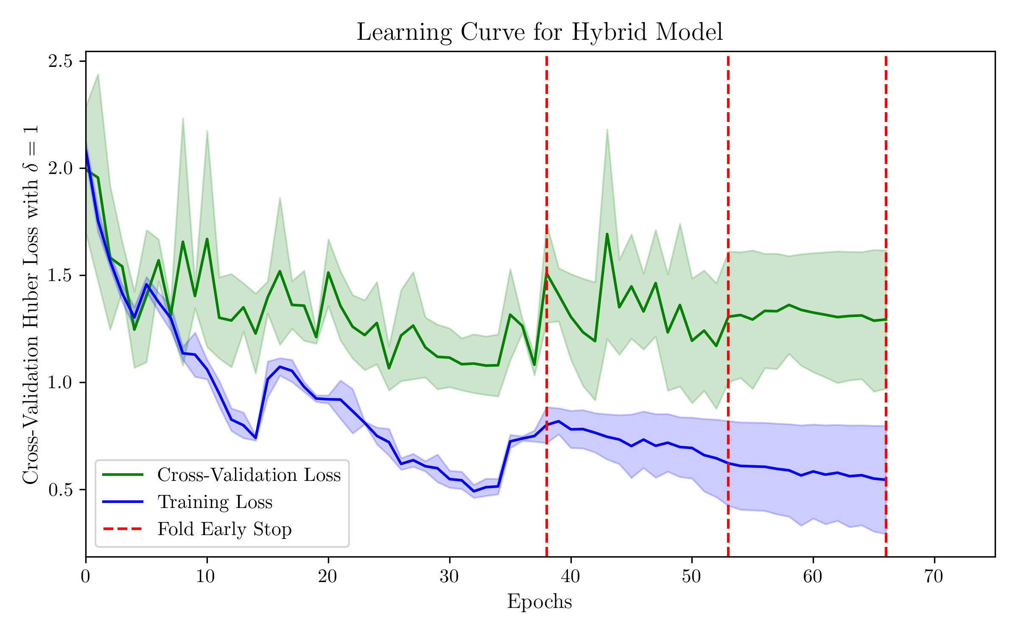
Image-based Regression - results

Slide 14
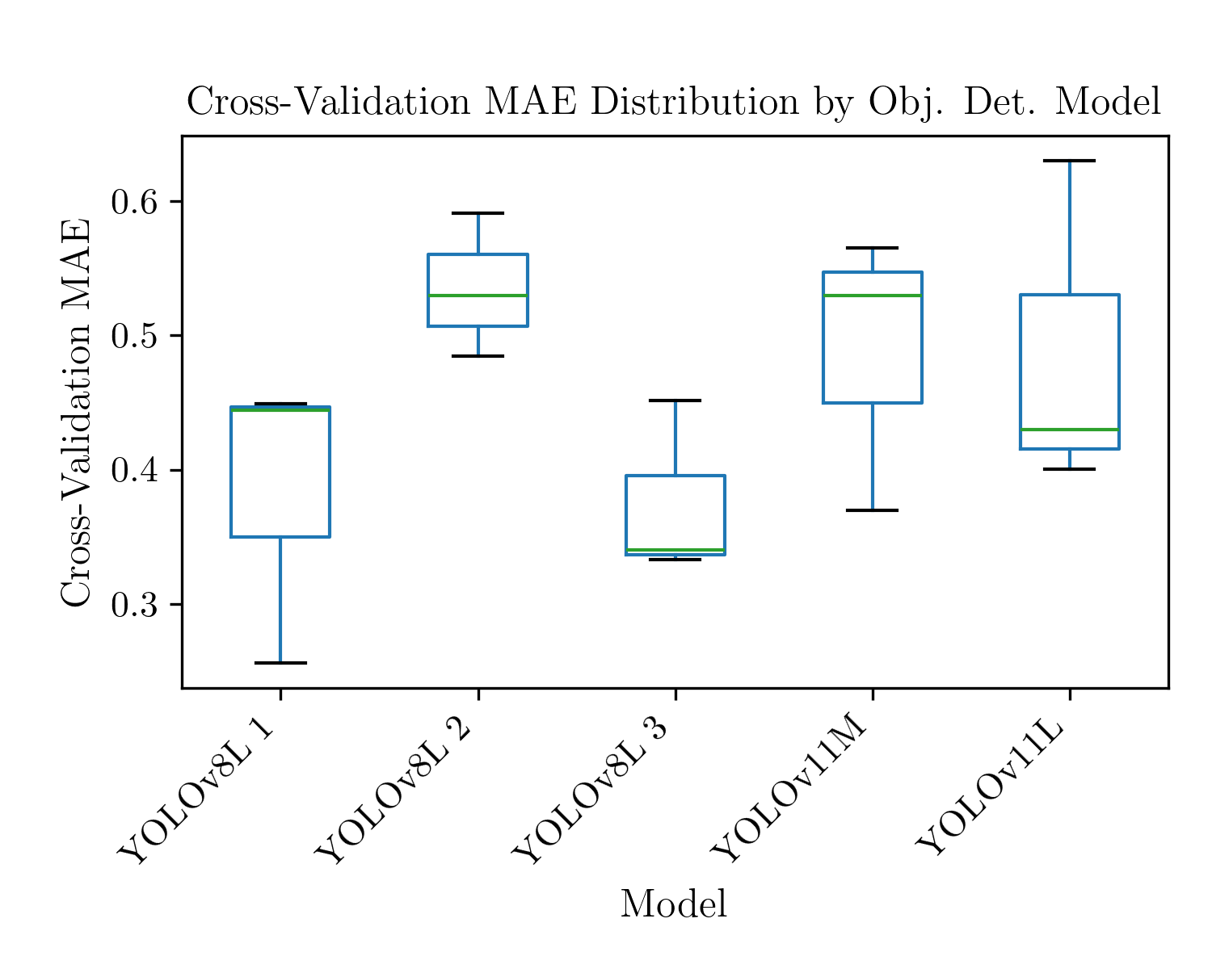
Object detection

Slide 15
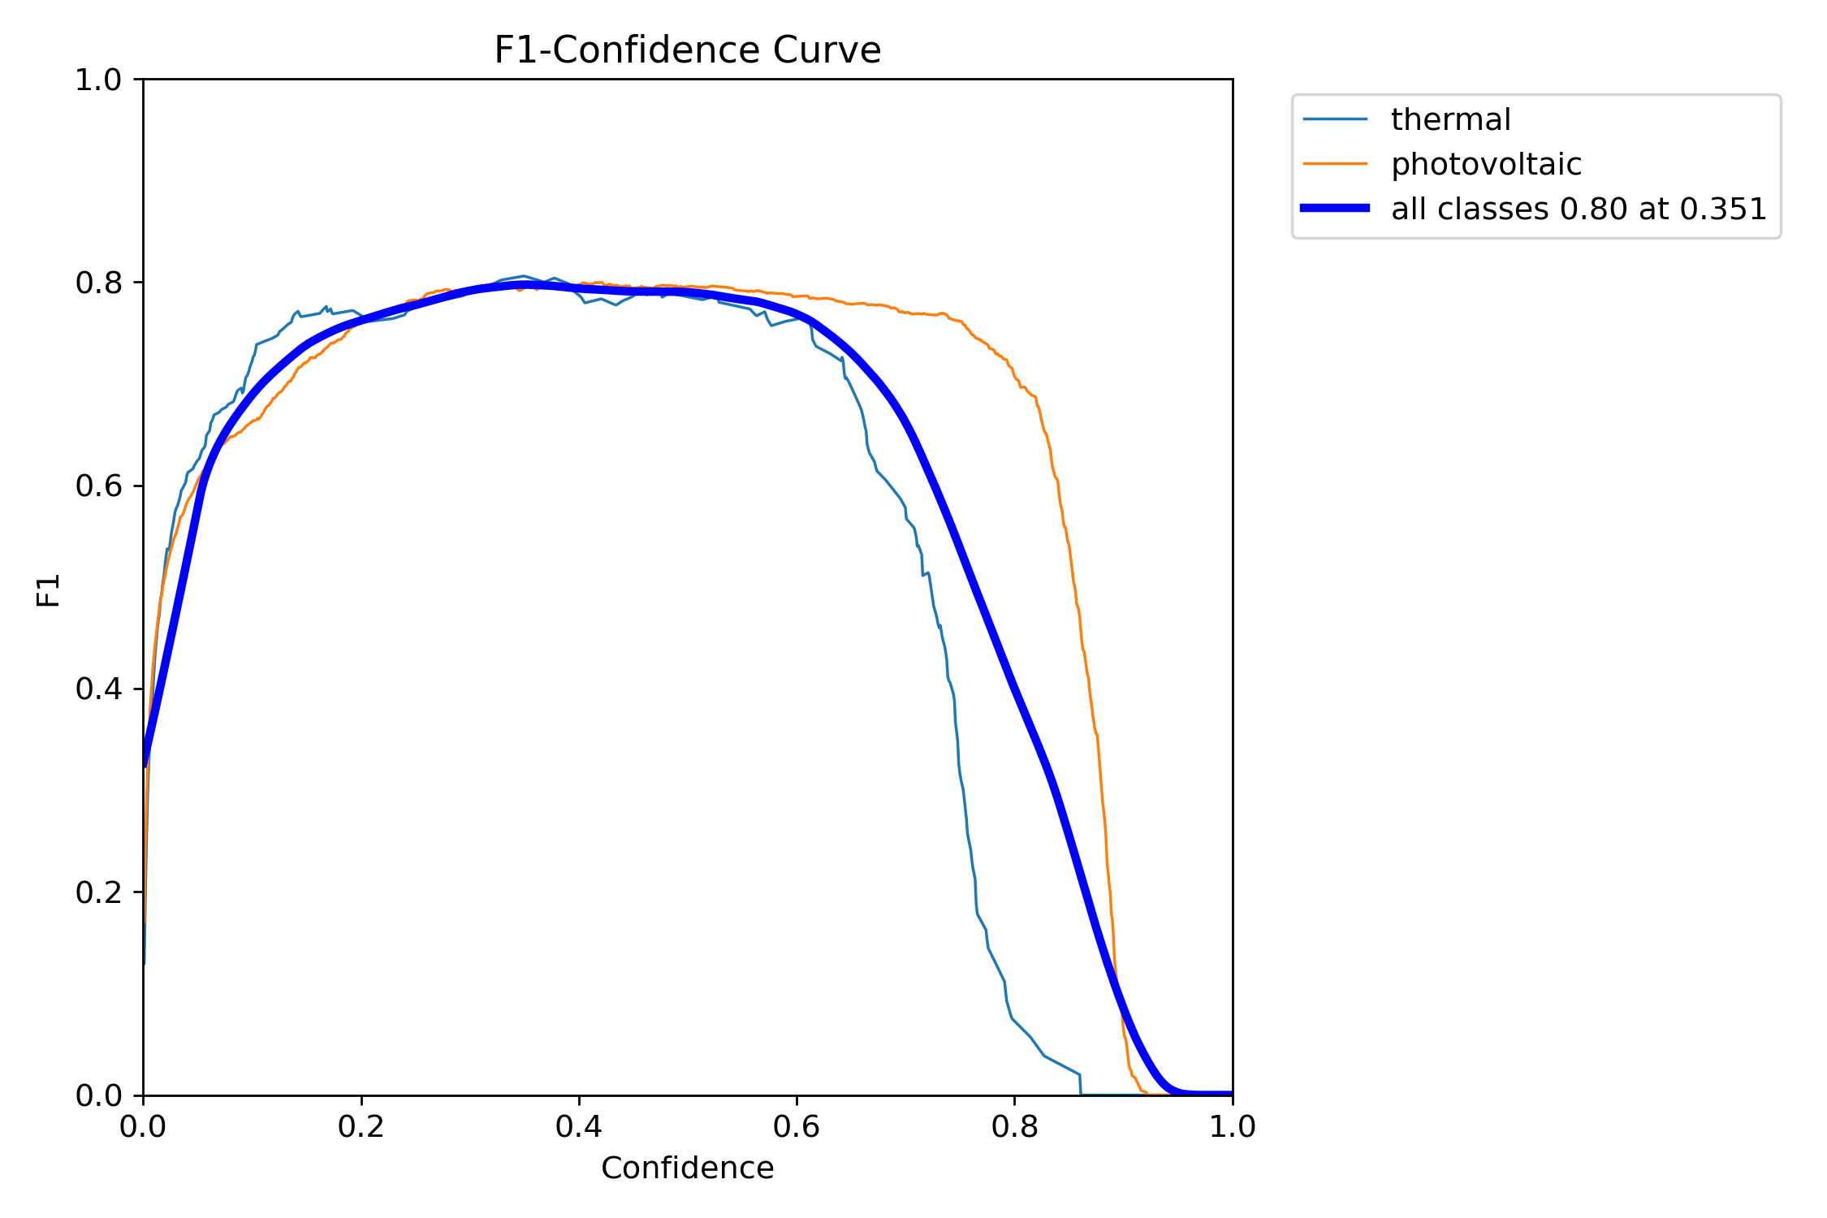
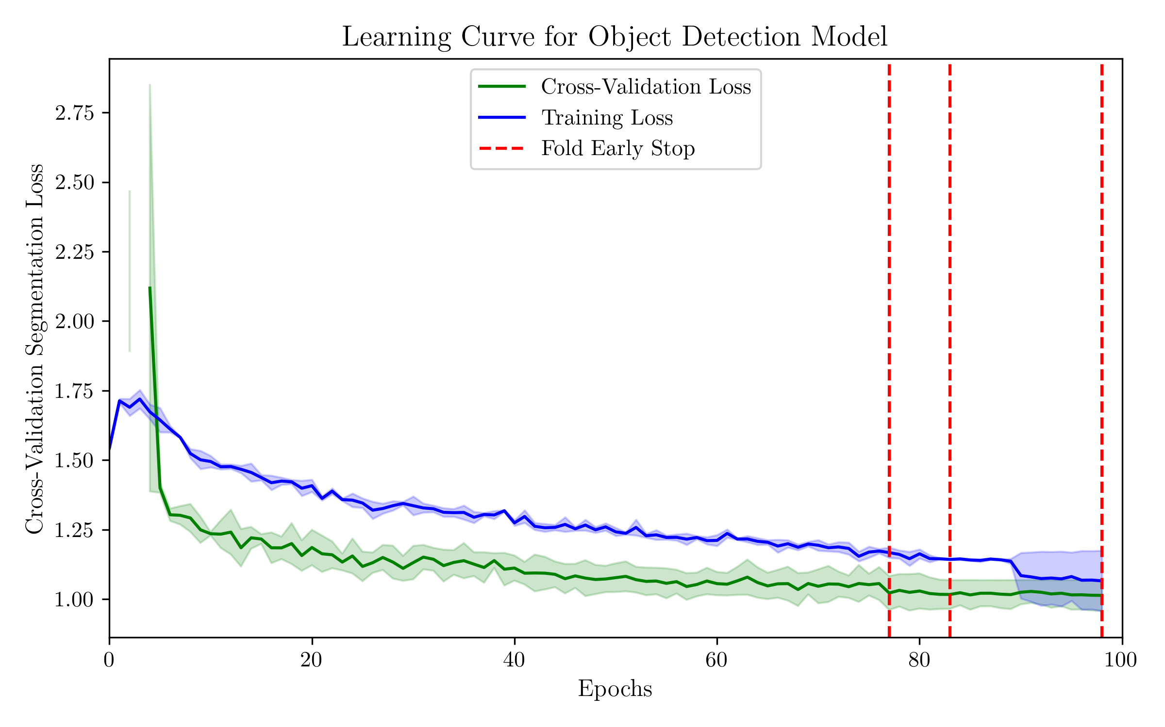
Object detection - results

Slide 16
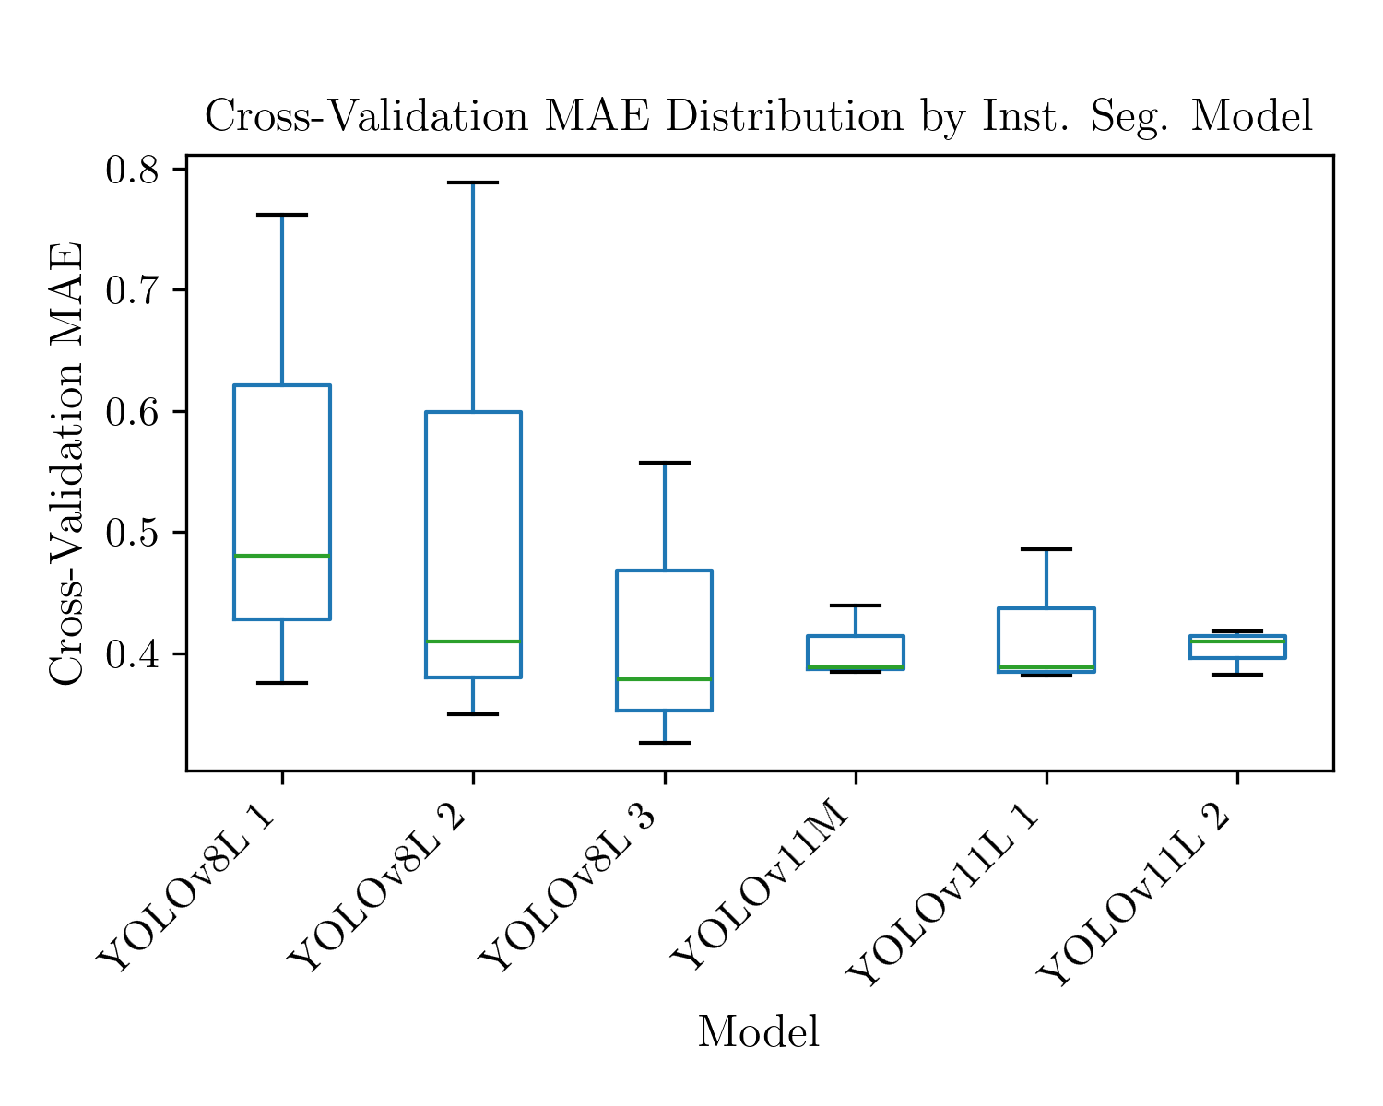
Instance segmentation

Slide 17
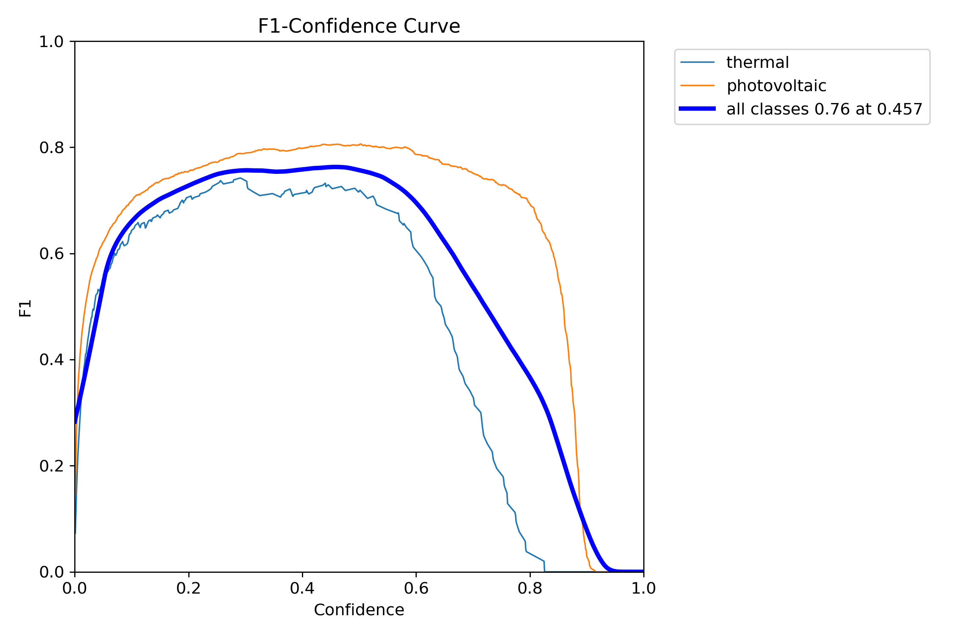
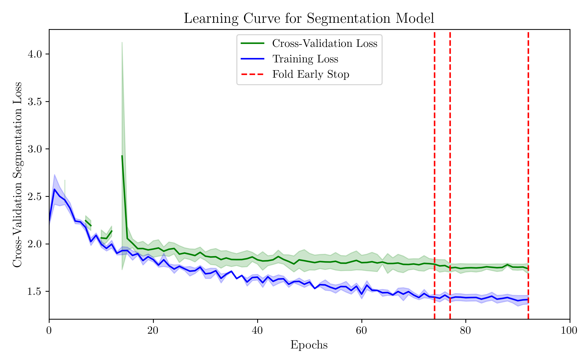
Instance segmentation - results

Slide 18
Results analysis

Slide 19
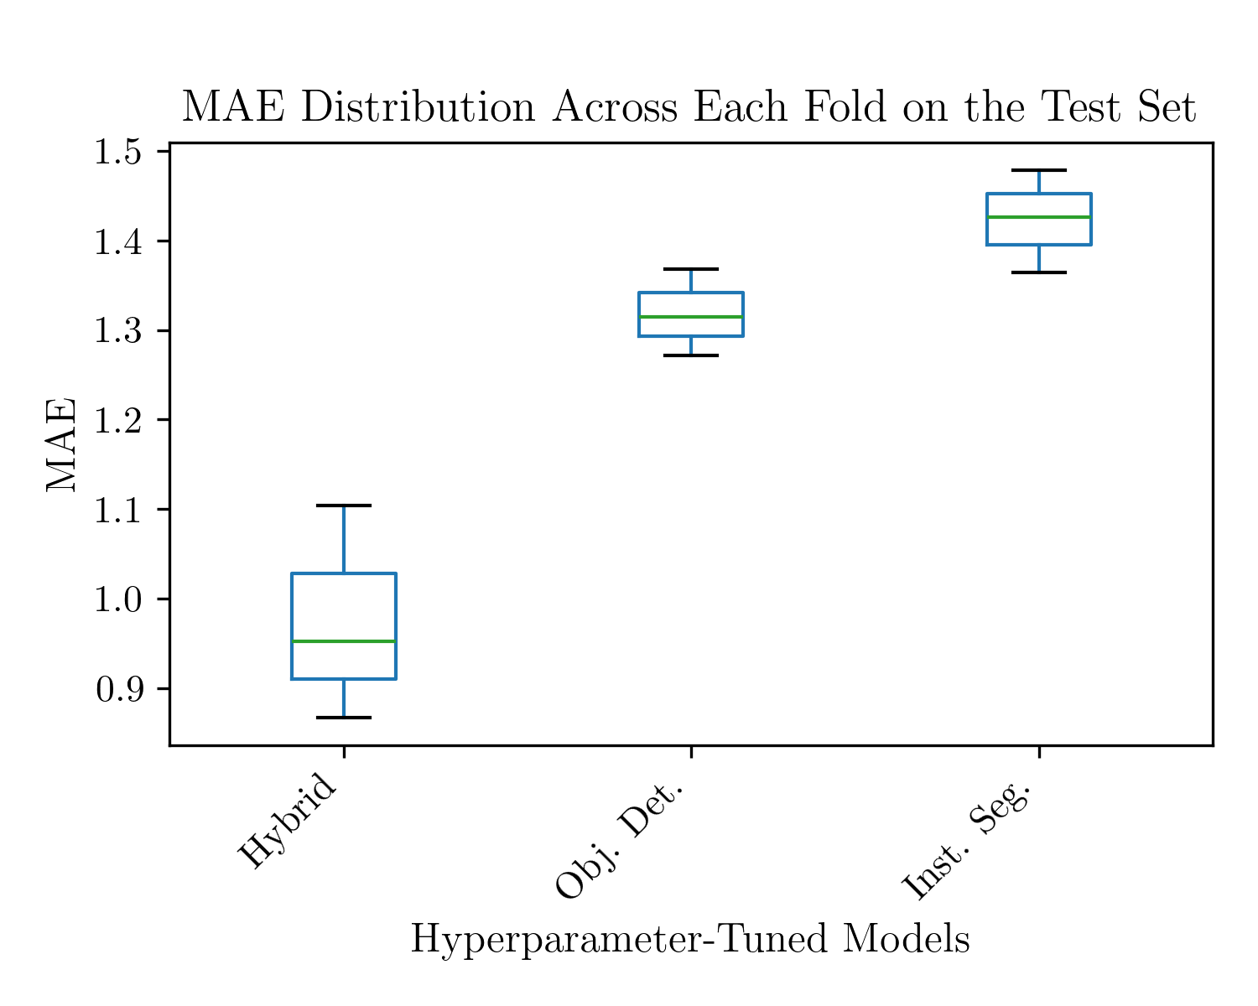

Slide 20
Aka discussion w lit benchmark

Slide 21
conclusions

